Slide 1
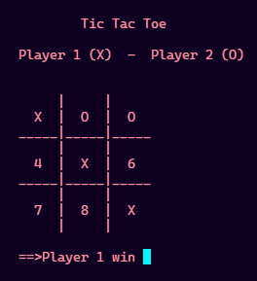
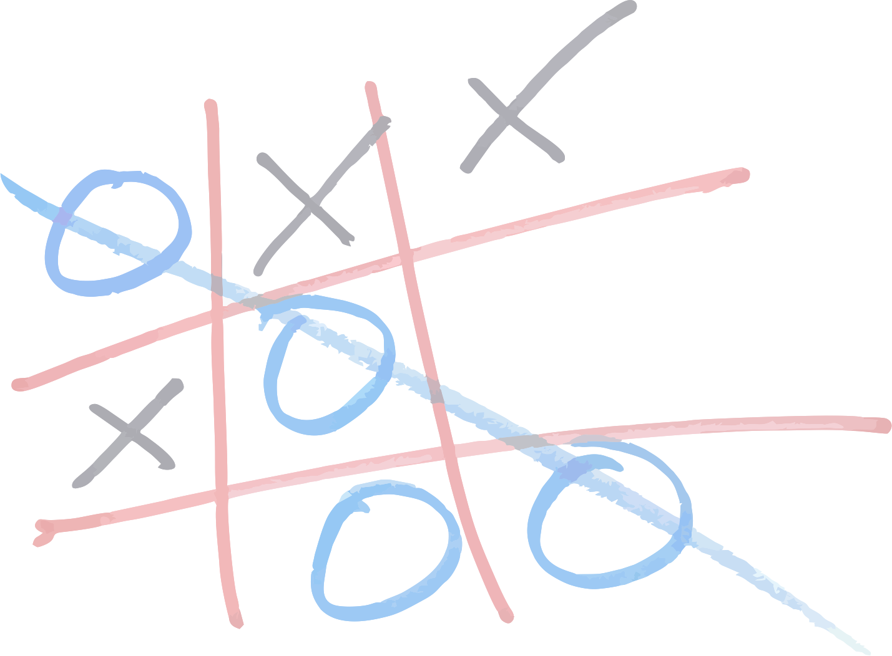
Tic Tac Toe
(Console Game) C++ Program
Hariom Kumar

Slide 2
Introduction to Tic Tac Toe
(Console Game) C++ Program
Tic-tac-toe (or Noughts and crosses, Xs and Os) is a pencil-and-paper game for two players, X and O, who take turns marking the spaces in a 3×3 grid. The player who succeeds in placing three respective marks in a horizontal, vertical, or diagonal row wins the game.
This program is a game program, Tic Tac Toe. Most of us have played this game in school days, we have make a C++ program on it.

Slide 3
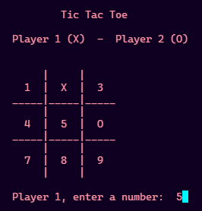
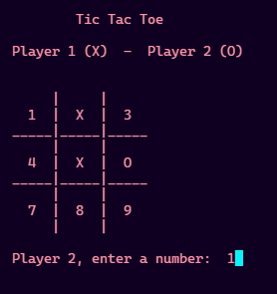
Introduction to Tic Tac Toe
(Console Game) C++ Program
This game uses board to control players In each turn players enter a number and choose a move
Simplify programing assumes that player one always moves first and uses X's
Player two moves at 2nd position and uses O's
A Sample Screen Shot of a Game

Slide 4

Introduction to Tic Tac Toe
(Console Game) C++ Program
How the program structured :
At the time when program start we initialize variables, and we run the game loop until the game end or players choose to quit
The game consists of three steps
Display board
Get players move
Check for game end(win/draw)

Slide 5
Initialization Of Variables &
explanatory statements
This portion of code is for initialization of variables, the variables of squares are initializing with the characters from 1 to 9.
The player turn will be initializing to 1 because since the player 1 makes the first turn
Game over is initialize to true but that does not really matter for this program because after game loop game check itself for winner.

Slide 6
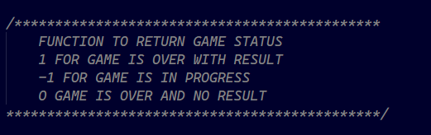
Initialization Of Variables &
explanatory statements
Program comments are explanatory statements that you can include in the C++ code that you write and helps anyone reading its source code. All programming languages allow for some form of comments.
C++ supports single line and multi-line comments. All characters available inside any comment are ignored by C++ compiler.
C++ comments start with /* and end with */. For example:
// This is a comment
/* C++ comments can also
span multiple lines
*/

Slide 7
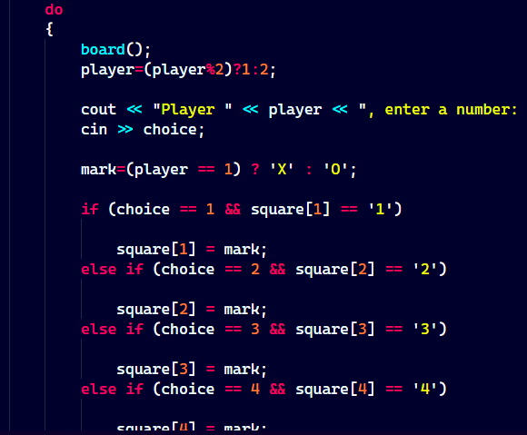
Game Loops
After initialization game began to move forward for main game loop these loops are while and do while loop which are encapsulated in statements that what to do or not to do.
Once we enter the game loop
The first thing will be done is print the game board which displays the tic tac toe game board in console window
Remember we initialize these squares with characters from 1 to 9 for basic console input and output.

Slide 8
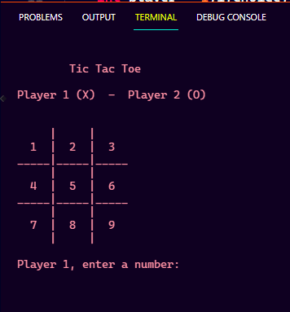
Game Loops
Notice that the console window prompts the player for move
The player's moves are handled by the next portion of code
When we run the program the board looks like this

Slide 9
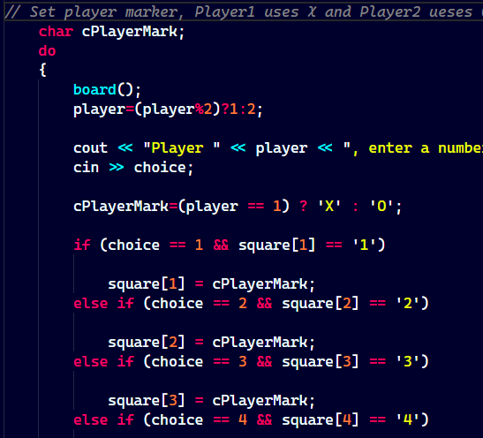
Game Loops
( player's moves )
cPlayerMark determines that first player has X and second has 0
This portion of statements check for player turn if it's not the first player move its promoted the move to next player
Then the next line gets the valid move of the player

Slide 10
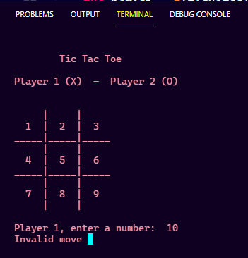
Game Loops
( player's moves )
If players input an invalid move it's prompted for another move and says try again like this ..
A Screen Shot of an Invalid Move

Slide 11

Game Loops
( player's moves )
The cin statement gets the valid move for the player
Notice that it's begin with another loop it has pretty much statements to check the conditions.
The check for valid move is pretty large branch of square check.

Slide 12
Game Loops
( player's moves )
Each branch of the if statement makes two check, the first input check that the input is valid digit from 1 to 9 and second check is for make sure of the input is digit not an character, second check also make sure that the number which is entered not entered
Previously
once a player moves the
square changes like this.

Slide 13
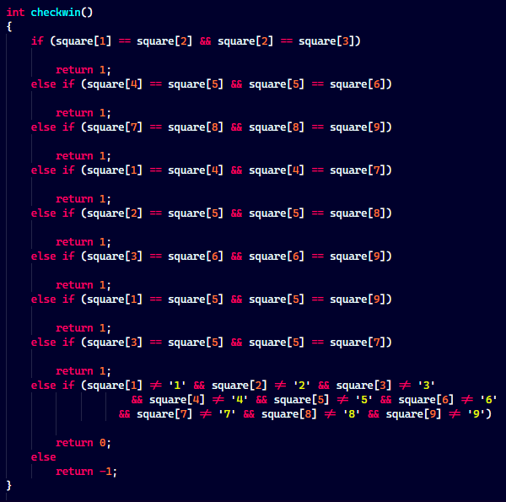
Game Loops
( player's moves )
After the valid move the series of checks perform to check the games conditions.
Note there are the nine ways to end the game, 8 conditions to win the game and 1 condition for draw the game.
All the conditions are checking according to the game rule.

Slide 14
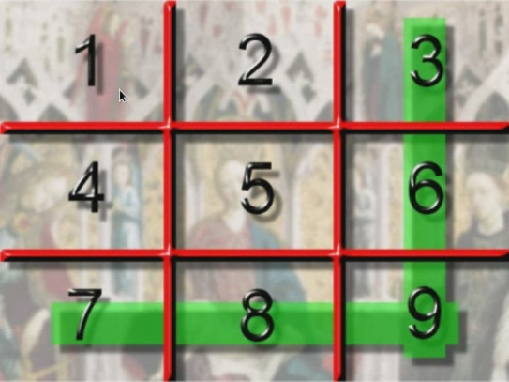

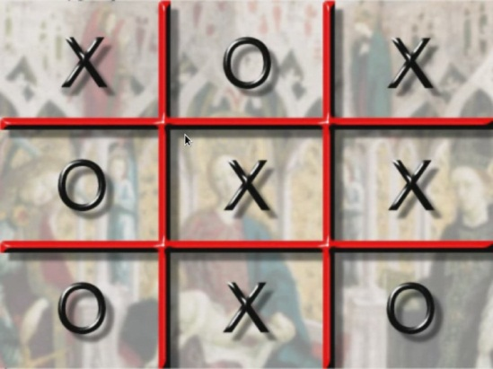
Game Loops
( player's moves )
In each of these cases we check that the squares not equals to its number character.
This check ensures that we have an extra O and the other two checks make sure that the other two squares have the same O in the series like this one
Those cases cover the win condition however game will be ended and draw like this.

Slide 15
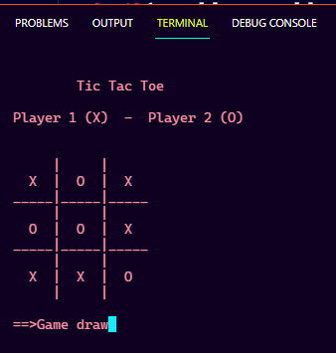
Game Loops
( player's moves )
Screen Shot “ Game Draw”

Slide 16
Summary
After the game result the game will end the user has to restart the game to play again.
The game result is totally based upon the user input and it will work for valid input else it will through error.
Thanks

